Slide 1
“Unemployment and Mortality: Evidence from the PSID” by Timothy J. Halliday
Zhengzheng Wang, Wei Zhan

Slide 2
Motivation
Research with micro-data shows that job displacement is associated with increases of mortality risk (Sullivan and von Wachter 2009, Strully 2009)
In contrast, study based on aggregate data suggests that worsened macroeconomic conditions are associated with lower mortality (Ruhm 2000, Miller et al 2009, Huff-stevens et al 2011)

Slide 3
Research Question
Relationship between macroeconomic conditions (county-level unemployment rates) and mortality (PSID’s death file)

Slide 4




Method
Model
logistic CDF
unemployment rate in individual’s county of residence
SRHS health status dummies, quadratic age, educational attainment dummies and Caucasian dummy
indicator that if the individual has dies within 5 years of the baseline at year t

Slide 5
Method - Identification Strategy
Identification of the effect of unemployment fluctuations on mortality relies on the selection on observables assumption
Controlling for health status, education, age and race.

Slide 6
Data
PSID survey provides information on mortality: death year and the primary cause
Self-Reported Health Status (SRHS) 1984-1993: self reported health status (rate 1-5), gender, race, educational attainment and age
County level unemployment rate
Notes:
PSID: age between 25 to 80 from 1984 to 1993, provides

Slide 7
Data - Sample construction
Begin with 20,338 obs
Drop obs with incomplete information on SRHS(20,222)
Restrict to between ages 25 and 80(18,440)
Dropped individuals whose ages decline by more than one year or increased by more than two years (16,769)

Slide 8
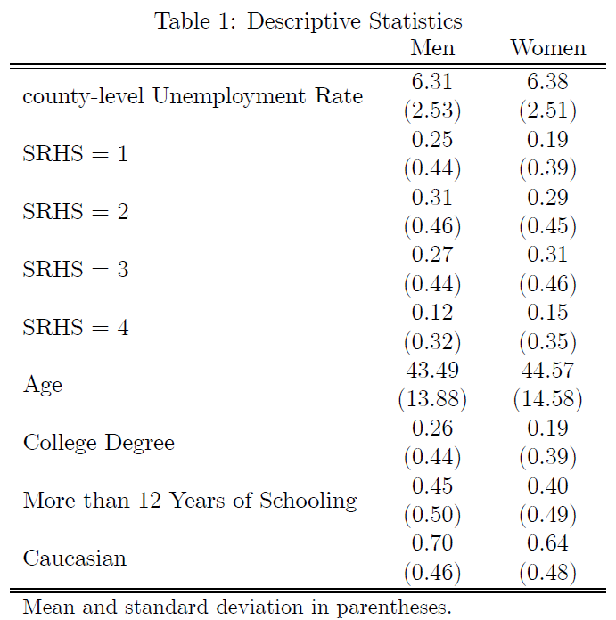

Slide 9
Results
Higher unemployment rate predicts higher mortality for men ages 60 and under
Significant effect of high unemployment rate on dying within three years of baseline
No significant effects for women or the elderly
Restricted to working-aged men:
  Effect on death caused by neoplasms increases
  Effect on death caused by diseases of the circulatory system decreases

Slide 10
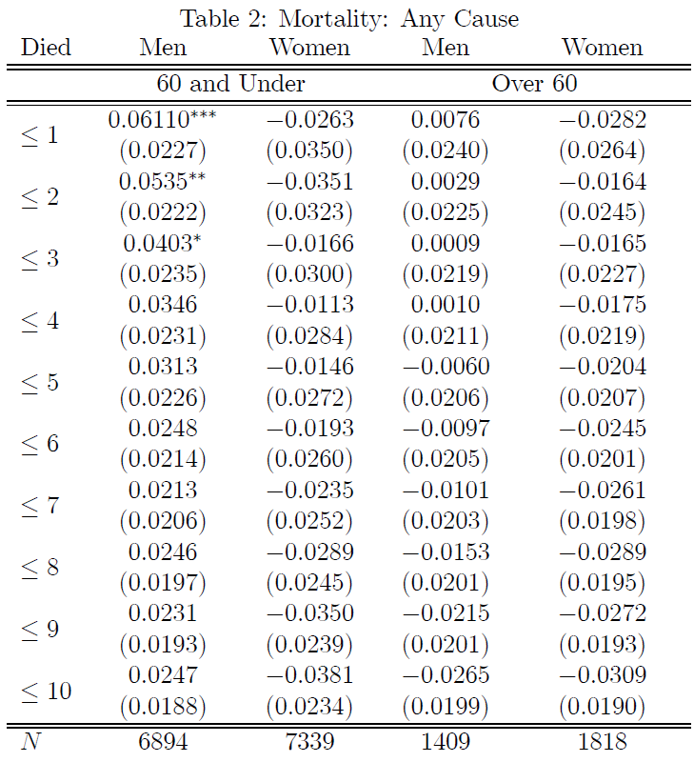

Slide 11
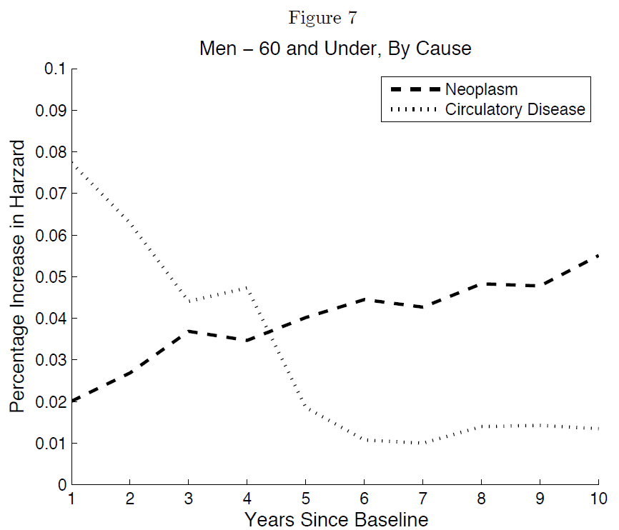

Slide 12
Robustness Check
For working-aged men: Inclusion of state and year fixed effects, industry dummies
Estimate the model without out-migration of healthy people
Results with and without health status

Slide 13
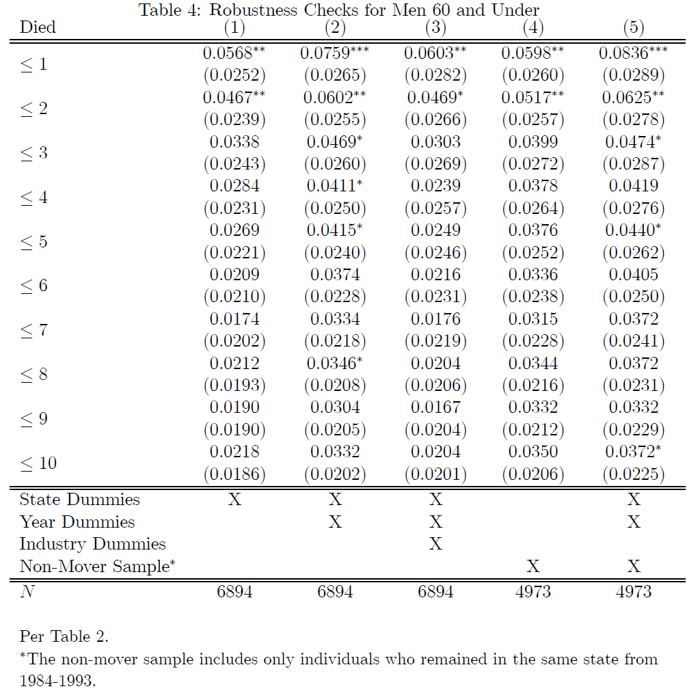

Slide 14
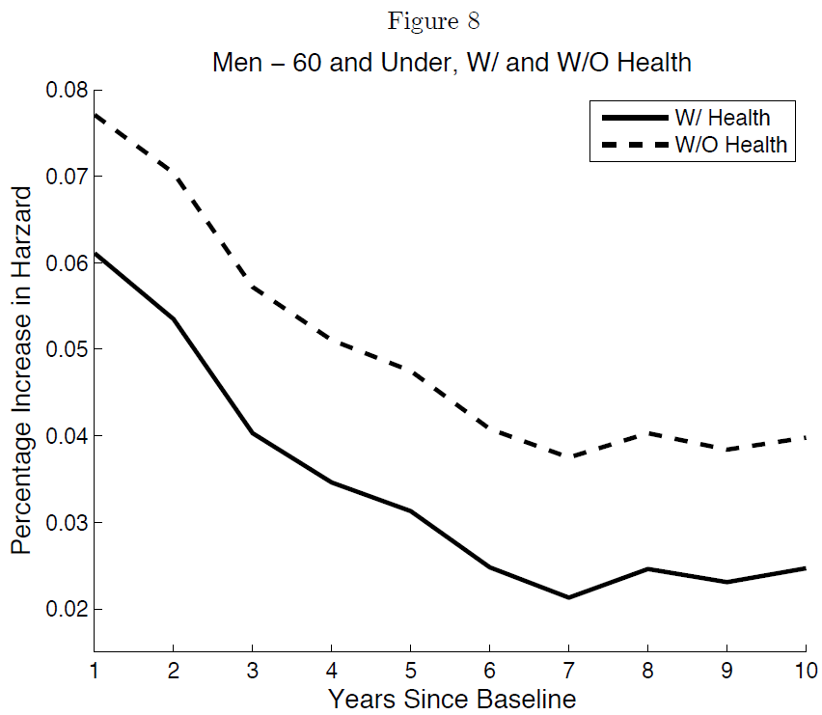

Slide 15


Implications - Decomposing the Effects
Total effect: 6% increase of mortality in first year → 24.1/100,000
Direct effect:3.4/100,000
Indirect effect: 20.7/100,000

Slide 16
Implications – Measurement of Policy Benefits
Lives saved: a government policy reduced the unemployment rate by 1% suggests that 24.1/100,000 fewer people died in the following year among the working-aged men

Slide 17
Conclusion
Current paper finds similar positive relationship between unemployment and mortality as previous micro-data work
Difference in results of current paper and macro work suggests the measurement errors through data aggregation
  Local economic shocks → out migrations → measurement of mortality rates change
Administrative data is needed

Slide 18
Pros and Cons
Contribution
  Do we learn anything new?
Selection on observable:
  Unemployment rate affects working-aged men differently than women and elderly
  Problematic because it’s hard to include all control variables
Doesn’t explain well what are the possible channels through which unemployment rate affects mortality
Implication
  Using estimates for working-age men to estimate the population effect could be a problem

